Slide 1
Redbus Data Scraping with Selenium & Dynamic Filtering using Streamlit

Slide 2
Problem Statement:
The "Redbus Data Scraping and Filtering with Streamlit Application" aims to revolutionize the transportation industry by providing a comprehensive solution for collecting, analyzing, and visualizing bus travel data. By utilizing Selenium for web scraping, this project automates the extraction of detailed information from Redbus, including bus routes, schedules, prices, and seat availability. By streamlining data collection and providing powerful tools for data-driven decision-making, this project can significantly improve operational efficiency and strategic planning in the transportation industry.
Business Use Cases:
The solution can be applied to various business scenarios including:
Travel Aggregators: Providing real-time bus schedules and seat availability for customers.
Market Analysis: Analyzing travel patterns and preferences for market research.
Customer Service : Enhancing user experience by offering customized travel options based on data insights.
Competitor Analysis: Comparing pricing and service levels with competitors

Slide 3
Preface :
Use Selenium to automate the extraction of Redbus data including routes, schedules, prices, and seat availability.
Open the redbus website, go through each state bus services and find the related information which need for extraction such as route links for diff busses, page no, bus details ect.
Link- https://www.redbus.in/
Copy the each state bus links and start the code implementation as shown in below.

Slide 4
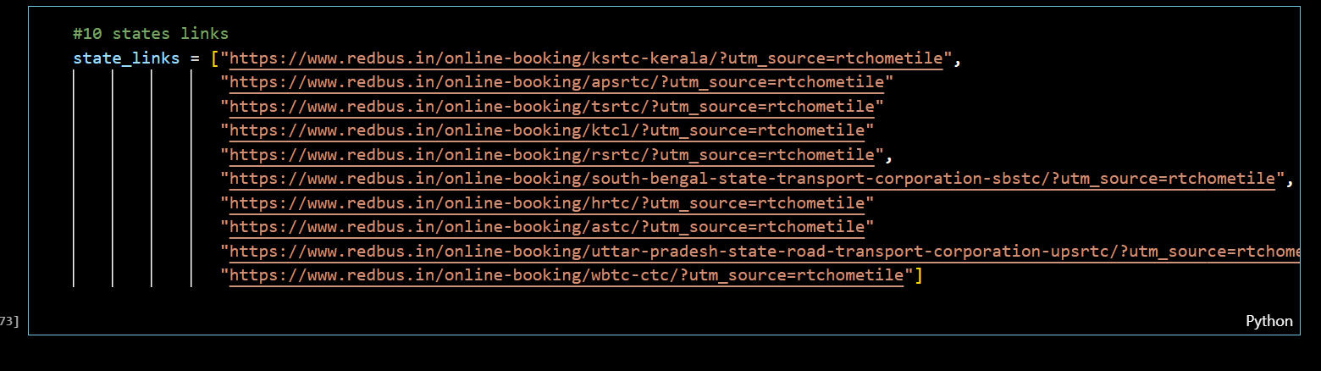
Code implementation
Import the required libraries,copy the state busses link and store in a list,for iterations,

Slide 5
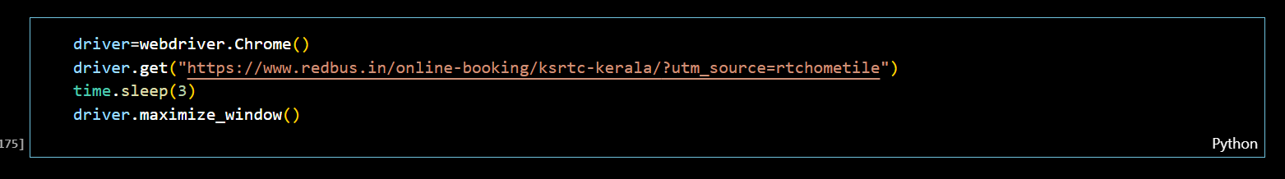
Retrieving the bus route link & converting into dataframe.
Initializes a Chrome Webdriver instance to control the Chrome browser.
Directs the browser to navigate to the given URL, The page specified is for KSRTC Kerala online bus booking.
Pauses the script for 3 seconds, Useful for ensuring the page loads fully before performing further actions. However, it’s better to use Webdriver's explicit waits for dynamic content.
Maximizes the browser window for better visibility and interaction

Slide 6
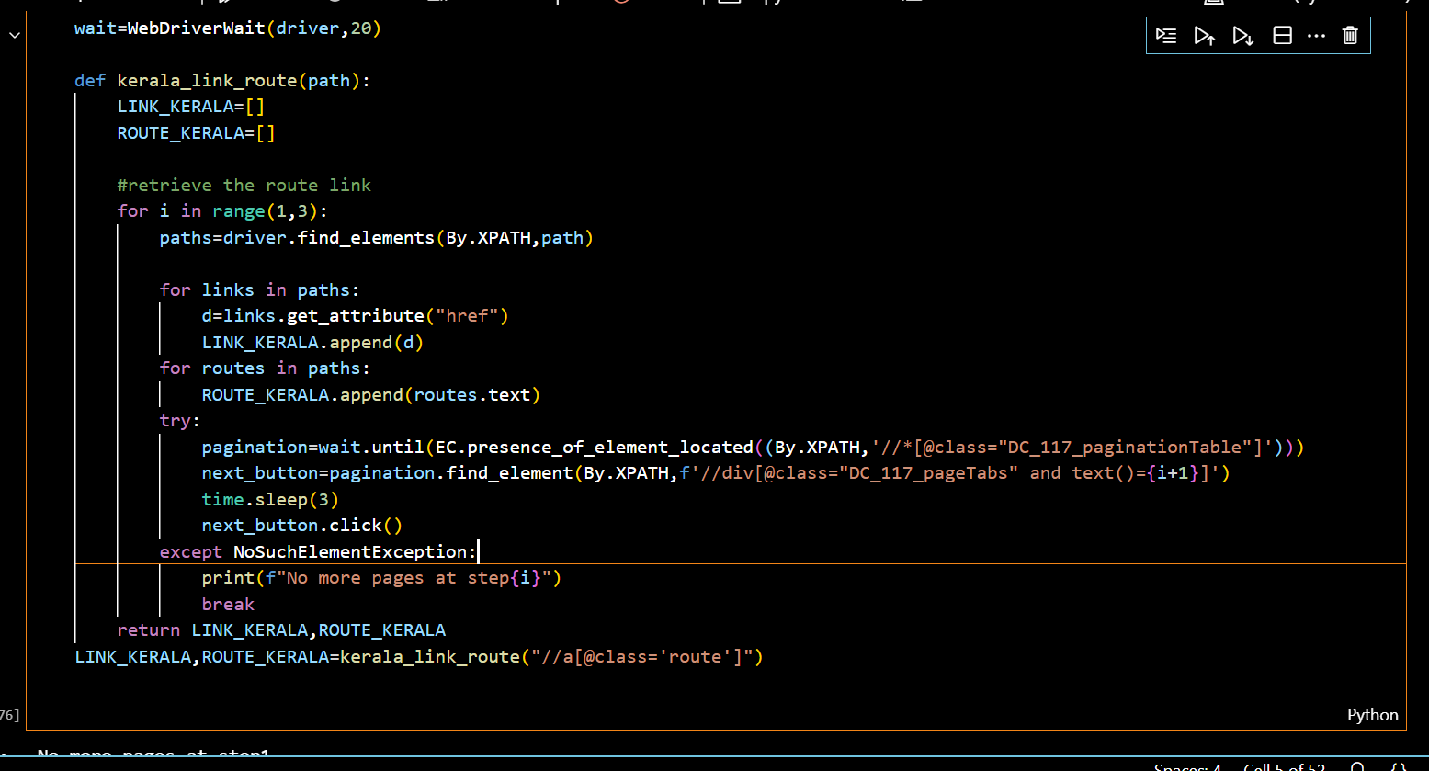
Retrieving the bus route link & converting into dataframe.
Core Logic
Initializes two lists: LINK_KERALA and ROUTE_KERALA to store URLs and route names.
Loops through pages (for i in range(1,3)):
Retrieve Links and Text:
Finds elements matching the provided XPath (path).
Extracts the href attributes and text from these elements and appends them to the respective lists.
Pagination Handling:
Locates the pagination section and clicks the "Next" button to navigate to the next page.
If the next page is unavailable, it catches the exception and exits the loop.
Do same for all state busses links

Slide 7
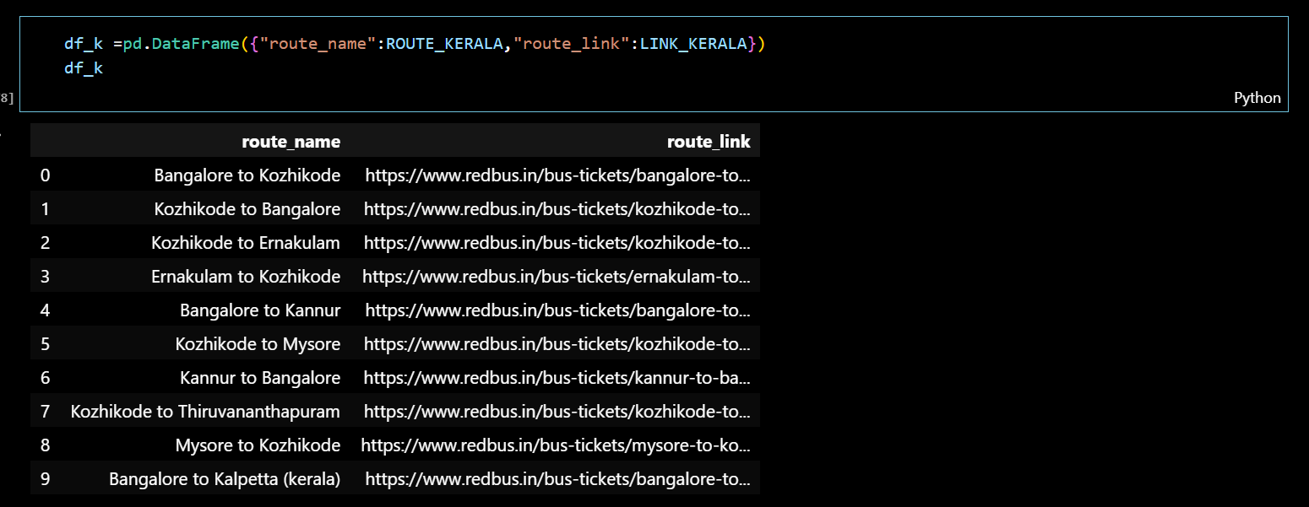
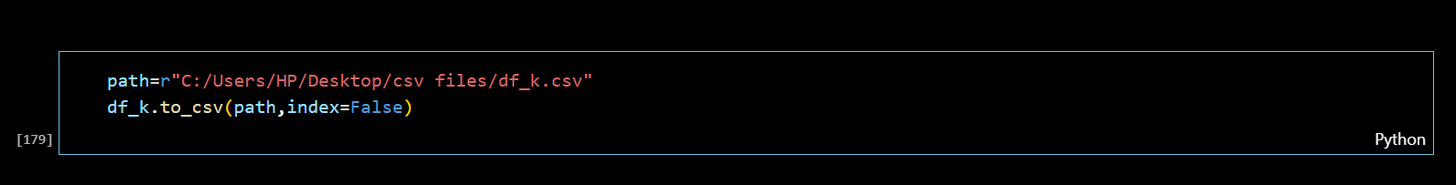

Slide 8
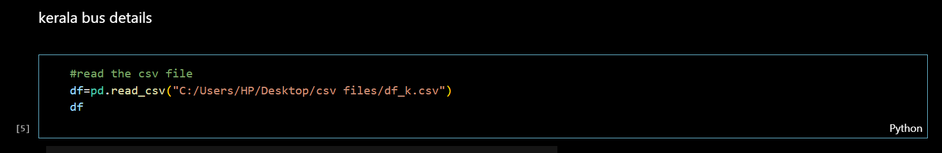
EXTRACTING THE DATA
Read the csv file.
Initialization
driver_k = webdriver.Chrome(): Creates a Chrome WebDriver instance for interaction.
Empty lists (Bus_names_k, Bus_types_k, etc.) are initialized to store extracted data.
Iterating Over Links
Loops through each row in the df DataFrame to get route_link and route_name.
Navigates to each route link using driver_k.get(link).
Clicking Elements
Finds and clicks elements matching the provided XPath to reveal details.
Attempts to click the "View Bus" button; skips to the next iteration if it fails.
Scrolling
Scrolls the page using ActionChains and compares the page source to detect the end of the scroll.
Extracting Data
Retrieves elements like bus names, types, start/end times, total duration, ratings, prices, and available seats.
Appends extracted data to the respective lists.
Output
Prints a success message upon completion

Slide 9
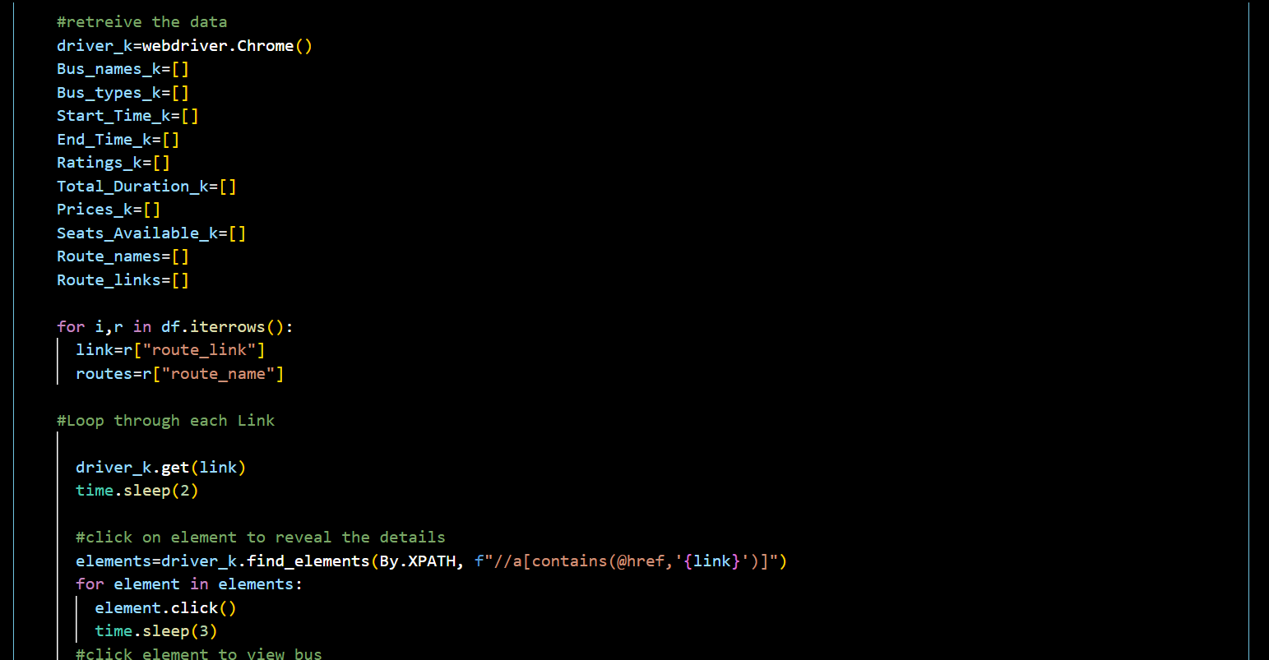
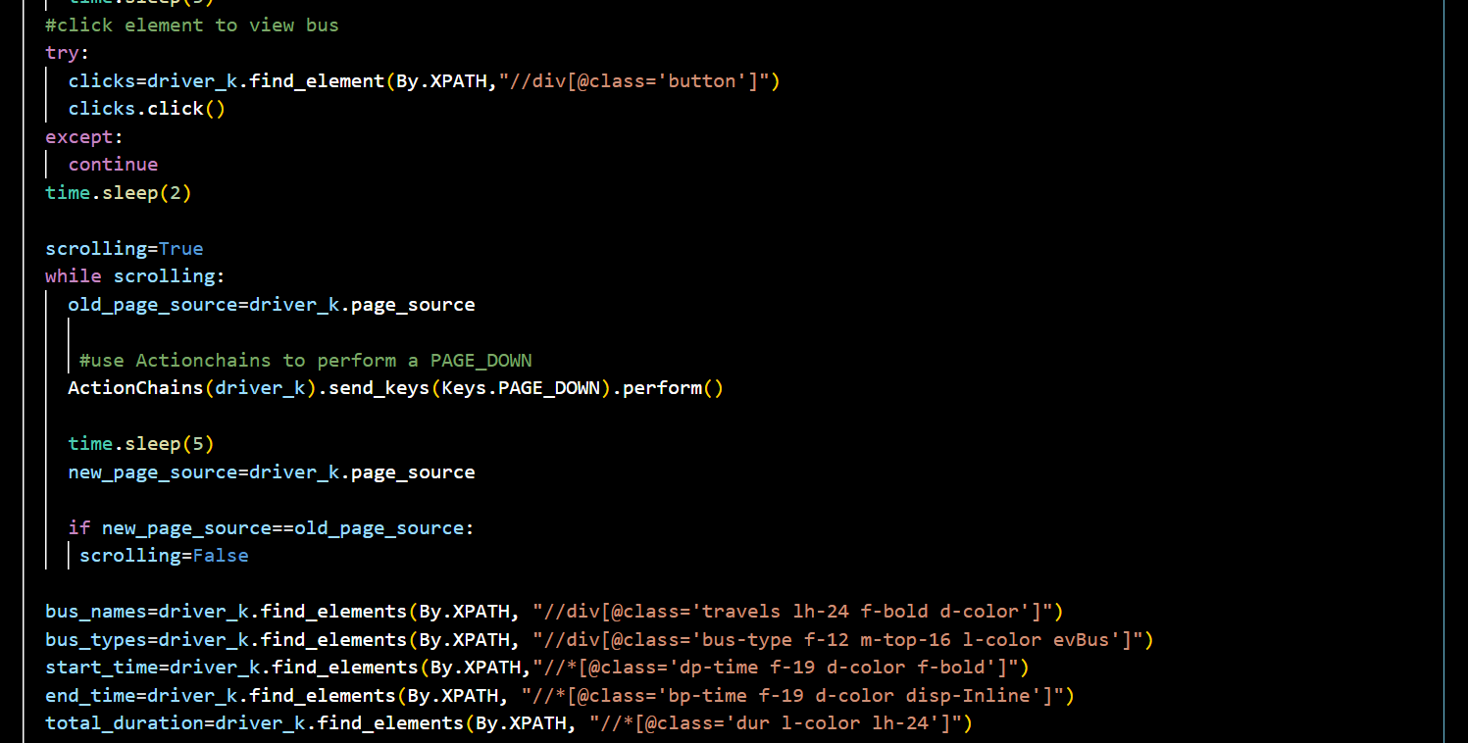

Slide 10
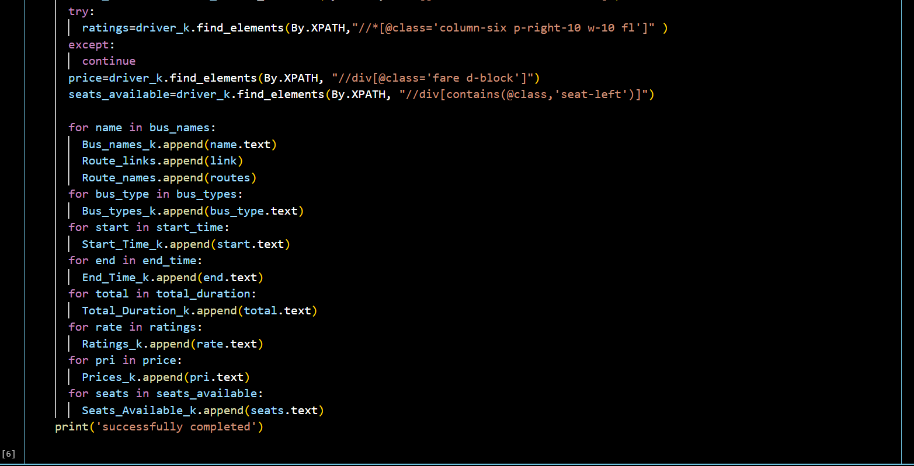
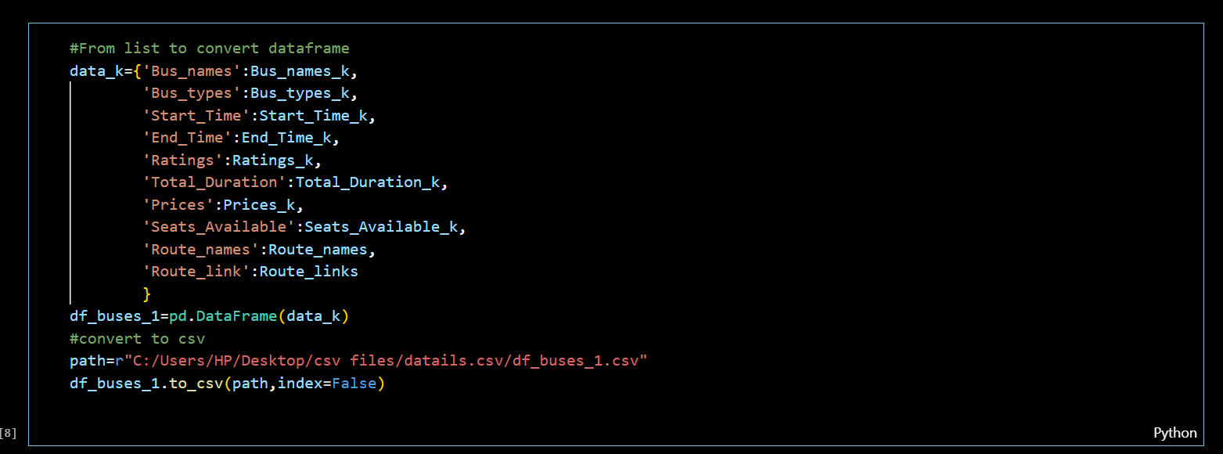
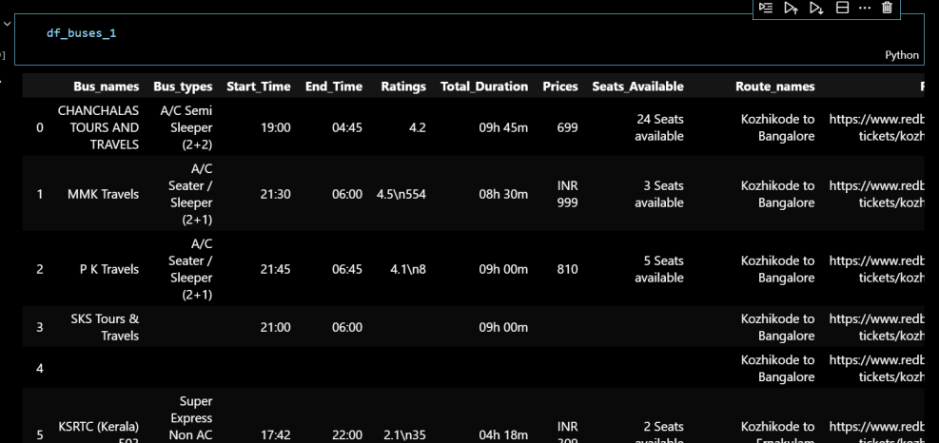
From list then convert into dataframe
Do same with all state busses

Slide 11
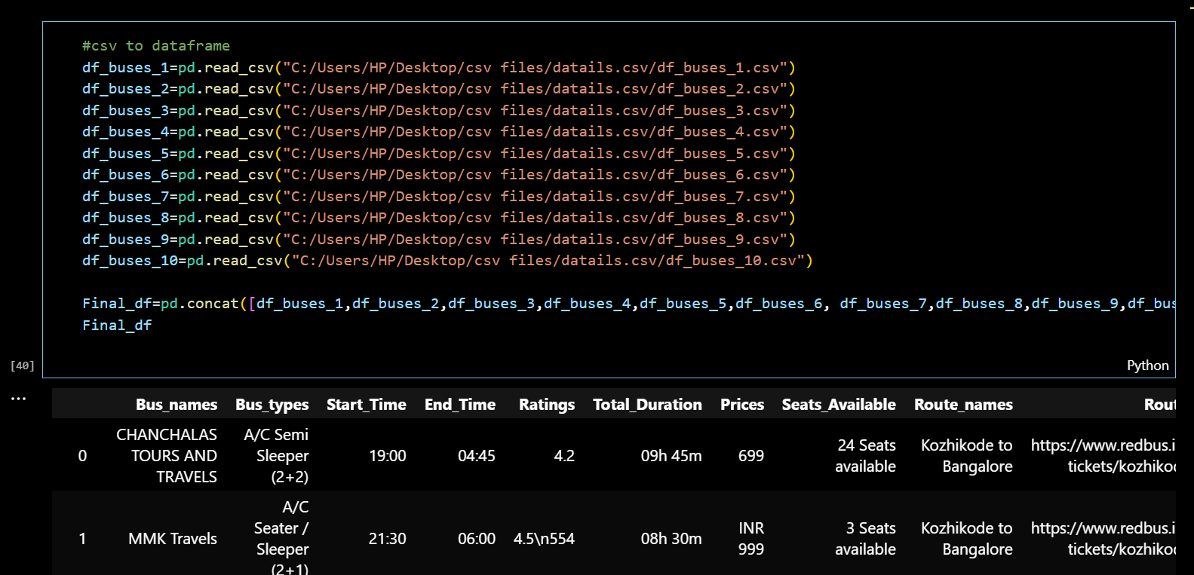
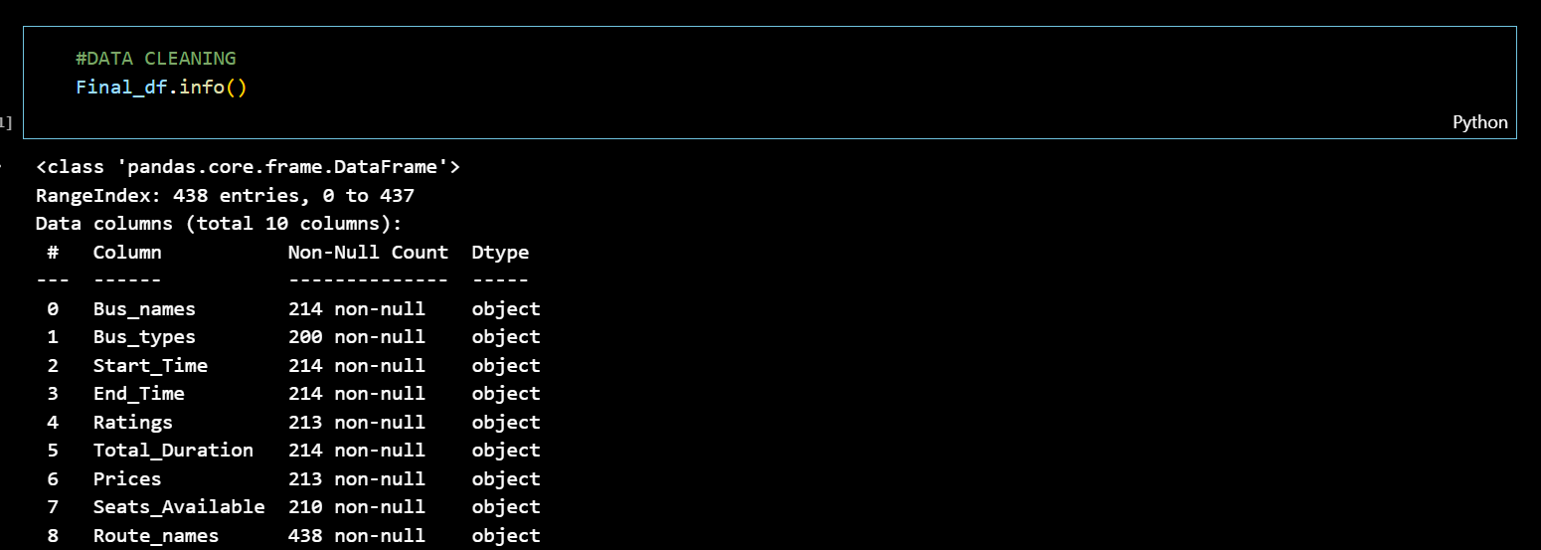
Concatenate all the csv into one data frame
DATA CLEANING :

Slide 12
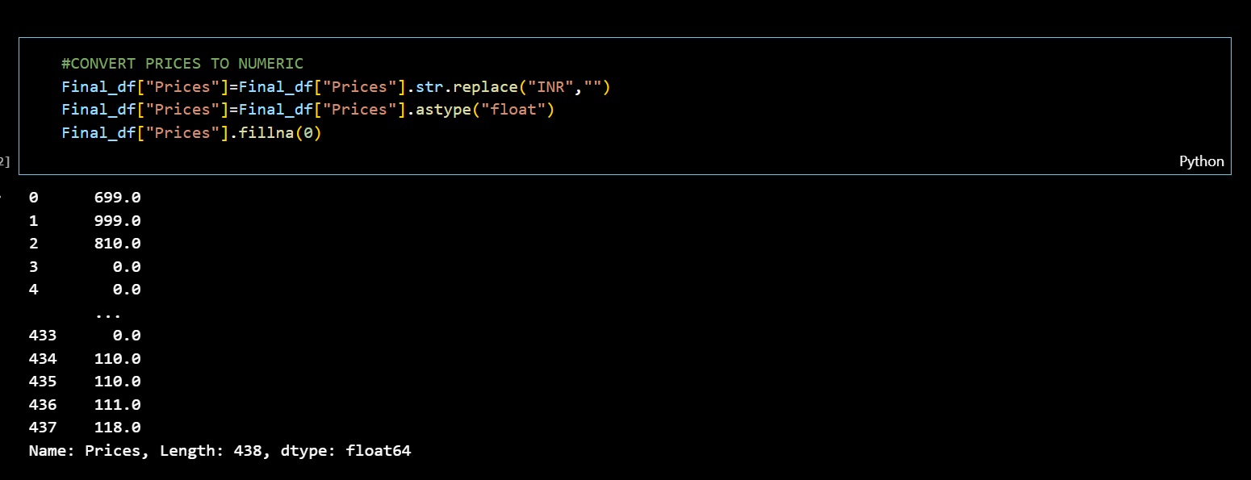
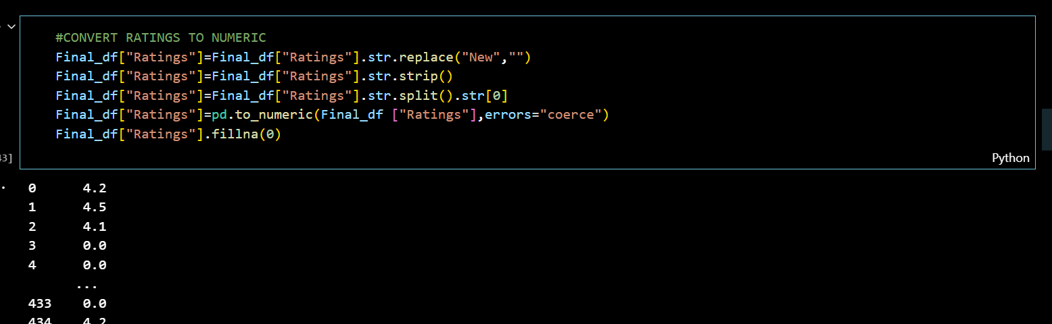
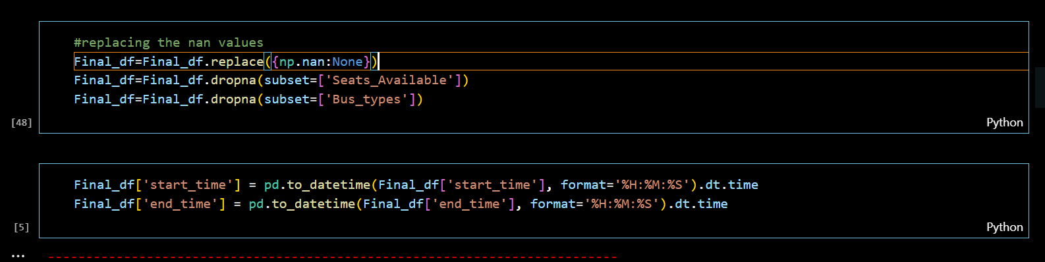
Change prices into Float, replace all object as empty, similarly ratings
Droppings the null row in seat availability & bus type
Change the start & End as datetime dtype

Slide 13
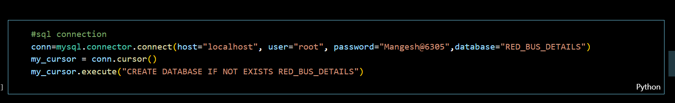
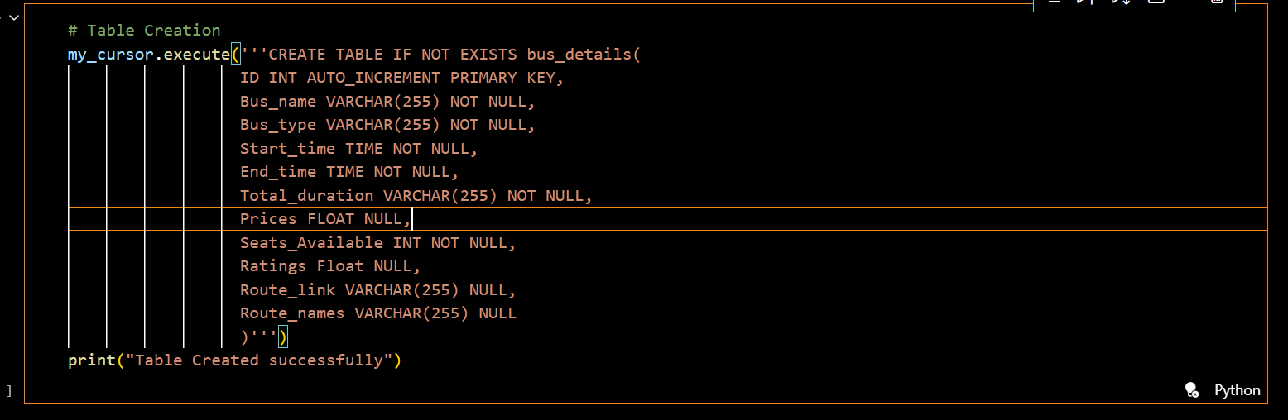
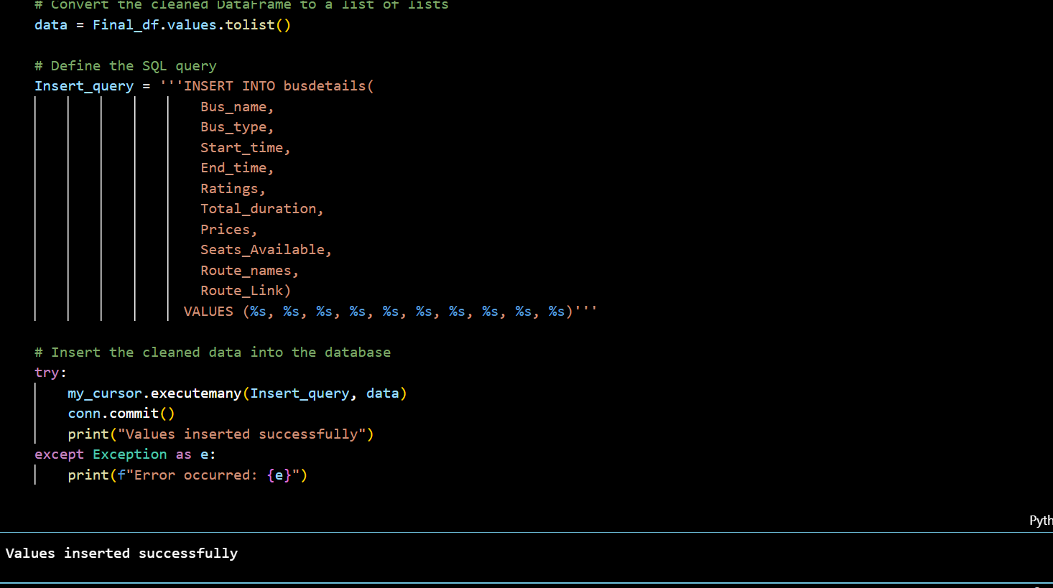
CREATE THE PYTHON SQL CONNECTION
Create the Table and columns.
Insert data into list through insert query,close the connection by commit.

Slide 14
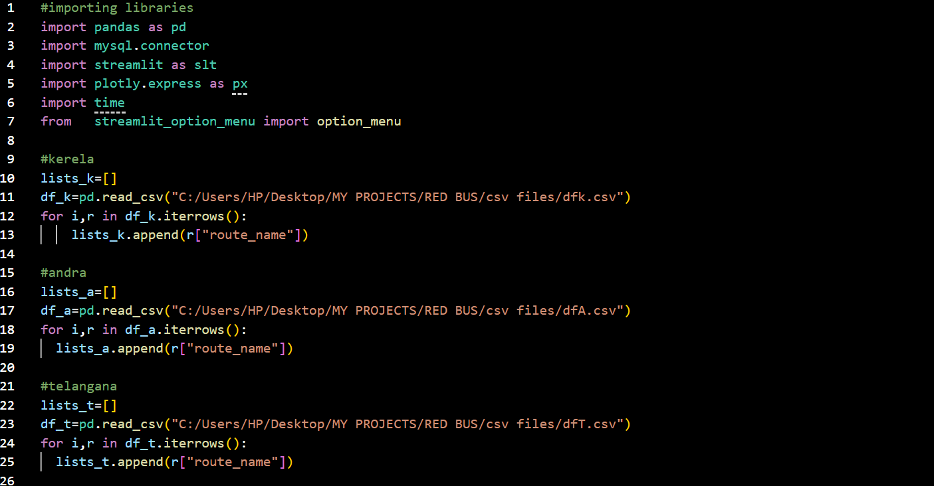
STREAMLIT APPLICATION
Iterating over each row & append the route name (NOTE: path given which data frame has route name and links)
Do same with all state links

Slide 15
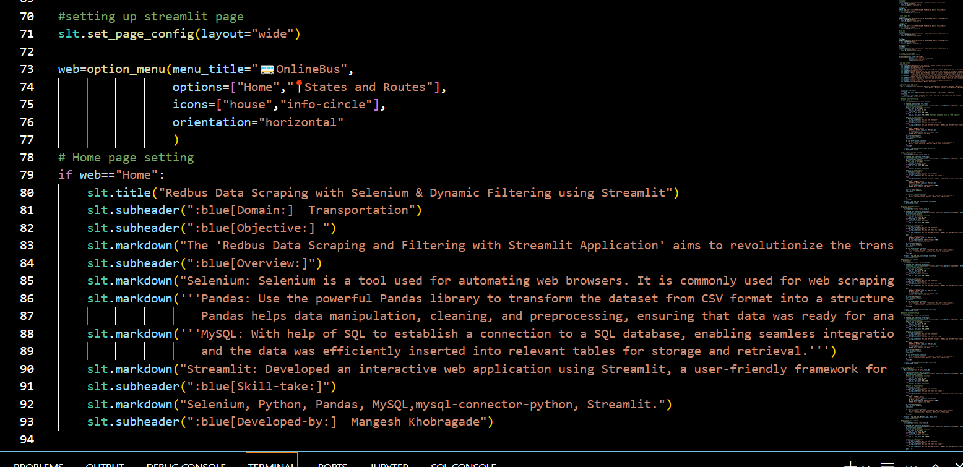
Setting up the streamlit page.
menu_title: Sets the title of the menu.
options: Specifies the menu items, such as "Home" and "States and Routes."
icons: Associates icons with the menu items.
orientation: Displays the menu horizontally.
slt.title: Displays the main title for the home page.
slt.subheader: Adds smaller headers for domain and objective.
slt.markdown: Uses Markdown to provide detailed text, explaining the project goals and methodology.

Slide 16
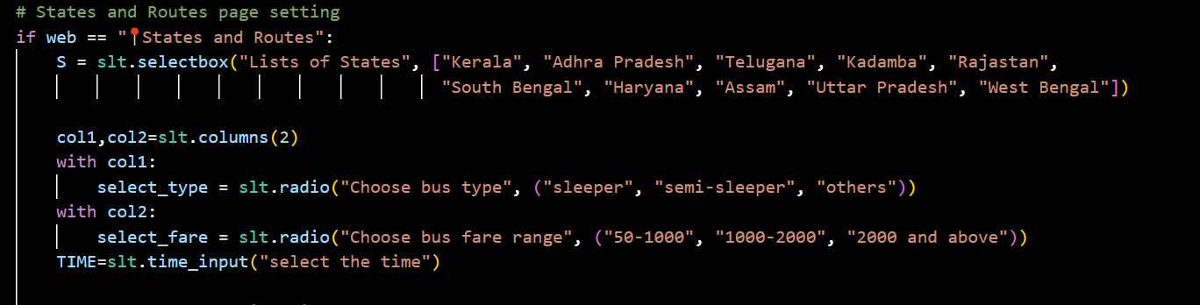
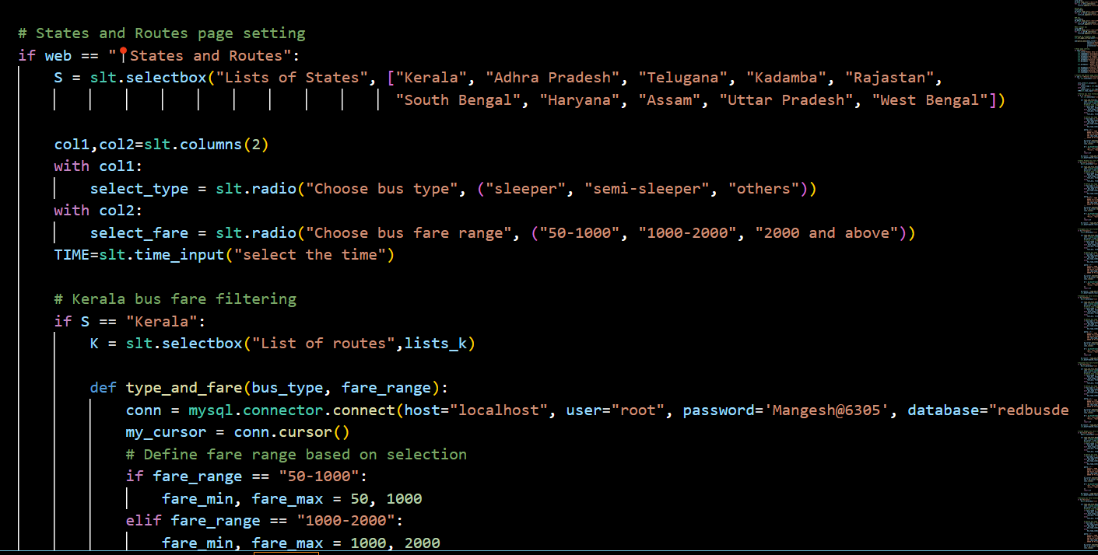
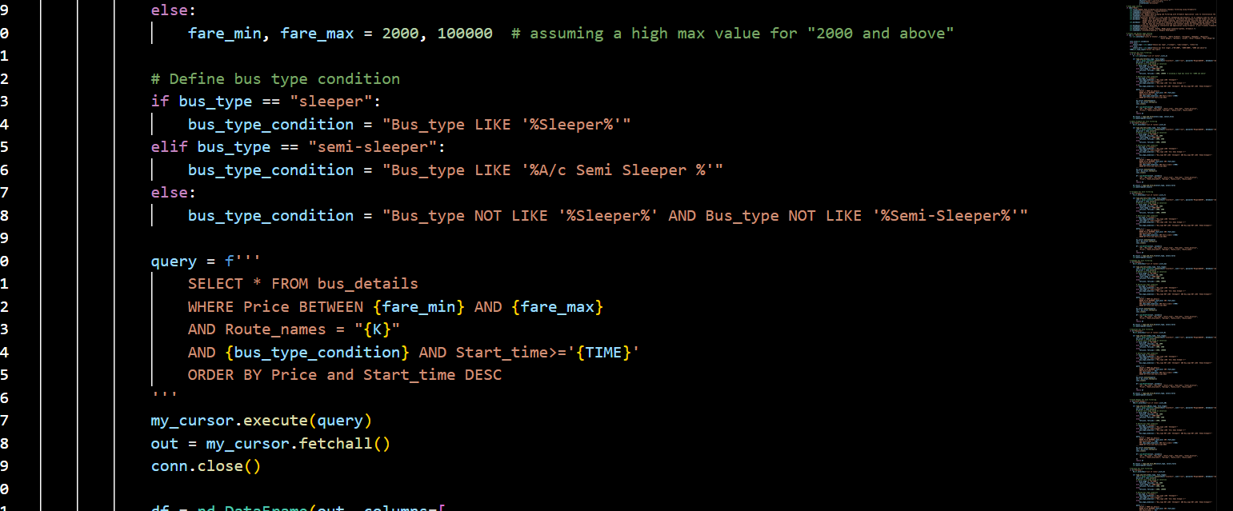
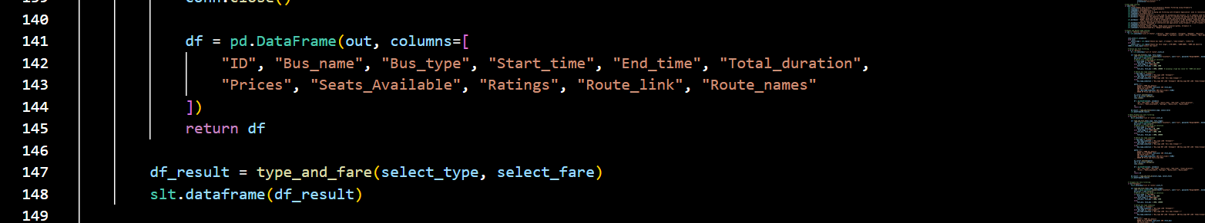

Slide 17
Allows the user to select a state from a dropdown menu.
Provides a horizontal layout for bus type and fare range selection using radio buttons.
Enables the user to specify a starting time for the journey.
Filters the routes for Kerala and presents them in a dropdown menu.
Connects to the database, builds a query based on user inputs, and fetches matching records.
Converts the query result into a pandas DataFrame for display.
Displays the filtered bus details in a table.

Slide 18
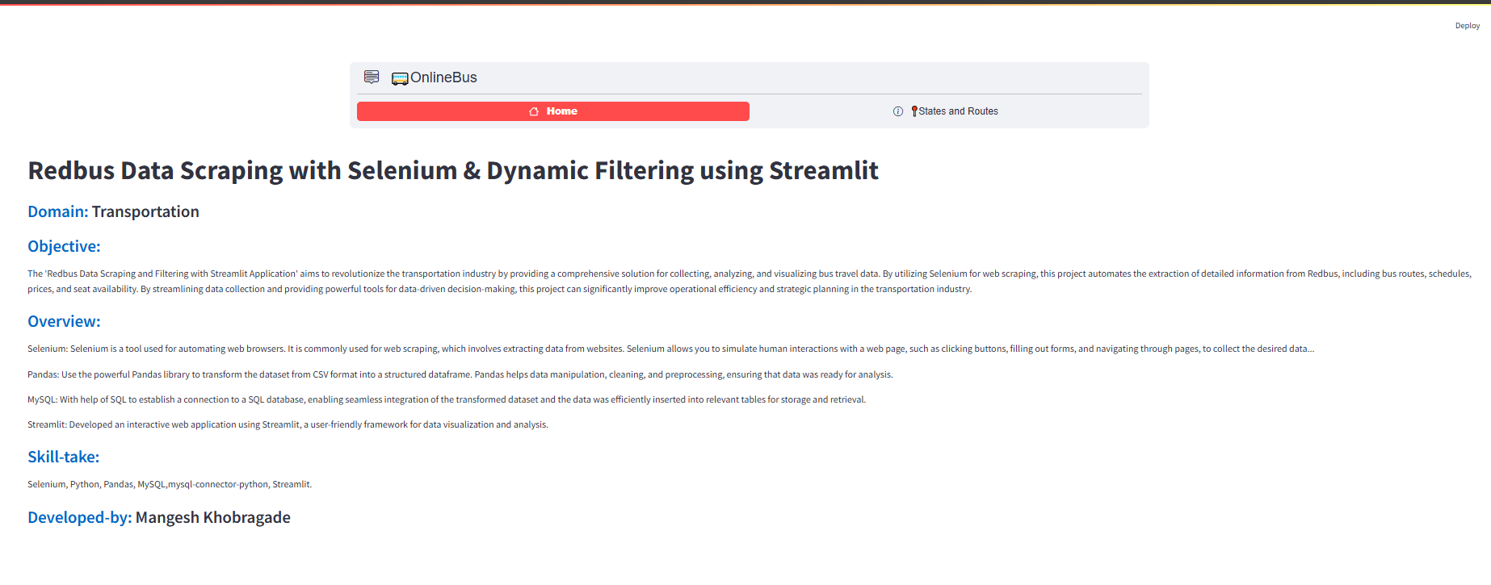
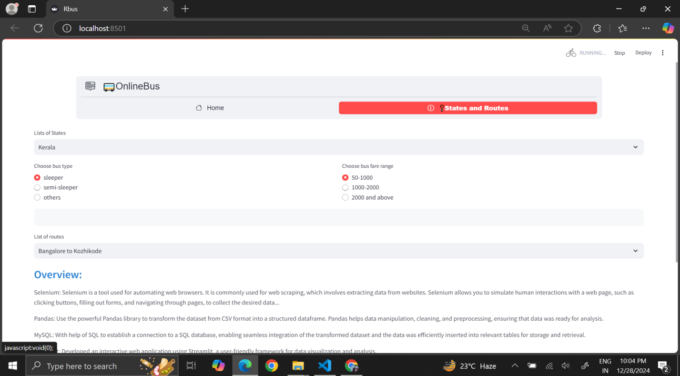
Output

